Slide 1

Lead Score Case Study
Sakshi

Slide 2
Problem Statement
An education company named X Education sells online courses to industry professionals. On any given day, many professionals who are interested in the courses land on their website and browse for courses.
The company markets its courses on several websites and search engines like Google. Once these people land on the website, they might browse the courses or fill up a form for the course or watch some videos. When these people fill up a form providing their email address or phone number, they are classified to be a lead. Moreover, the company also gets leads through past referrals. Once these leads are acquired, employees from the sales team start making calls, writing emails, etc. Through this process, some of the leads get converted while most do not. The typical lead conversion rate at X education is around 30%.
Now, although X Education gets a lot of leads, its lead conversion rate is very poor. For example, if, say, they acquire 100 leads in a day, only about 30 of them are converted. To make this process more efficient, the company wishes to identify the most potential leads, also known as ‘Hot Leads’. If they successfully identify this set of leads, the lead conversion rate should go up as the sales team will now be focusing more on communicating with the potential leads rather than making calls to everyone.

Slide 3
Goals of the Case Study
There are quite a few goals for this case study:
Build a logistic regression model to assign a lead score between 0 and 100 to each of the leads which can be used by the company to target potential leads. A higher score would mean that the lead is hot, i.e. is most likely to convert whereas a lower score would mean that the lead is cold and will mostly not get converted.
There are some more problems presented by the company which our model should be able to adjust to if the company's requirement changes in the future so we will need to handle these as well.

Slide 4
Approach
Source the data for analysis
Reading and understanding the data
Data cleaning
EDA
Feature Scaling
Splitting the data into train and test dataset
Prepare the data for modeling
Model building
Model Evaluation – Accuracy, Sensitivity and specificity
Precision Recall
Making prediction on the test dataset

Slide 5
Data Sourcing, Cleaning & Preparation
Read the data from CSV file
Outlier Treatment
Data Cleaning, Handling Null values and Removing higher null value data
Removing Redundant columns in the data
Imputing Null values
Exploratory Data Analysis – Approx conversion rate is 38%
Feature Standardization

Slide 6
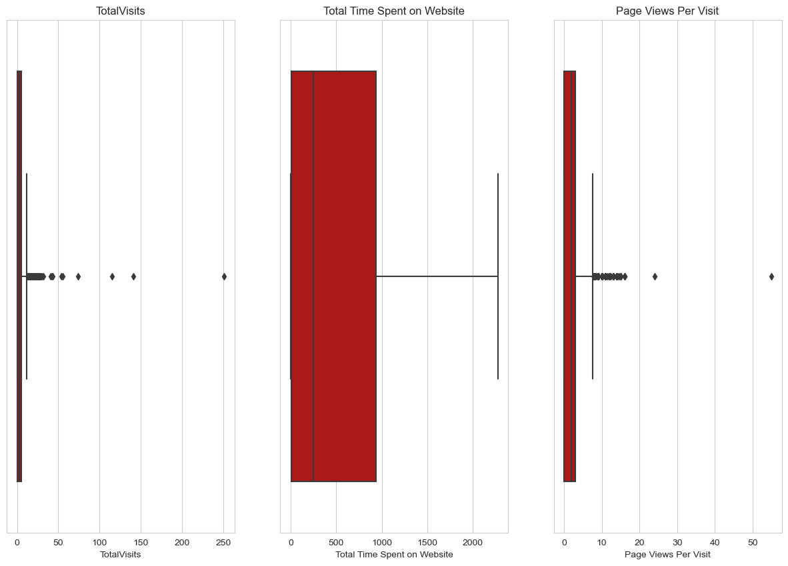
Outliers: Total visits, Total time spent on website, Page views per visit have outliers.
From the above boxplots we can observe two outlier variables in our dataset ('TotalVisits' and 'Page Views Per Visit').
We need to do a 0.99-0.1 analysis in order to correct the outliers.

Slide 7
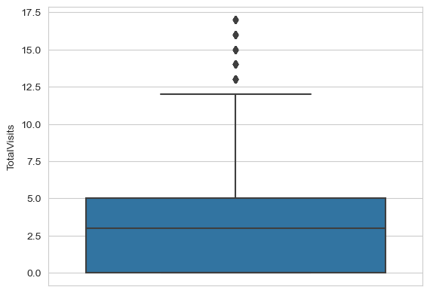
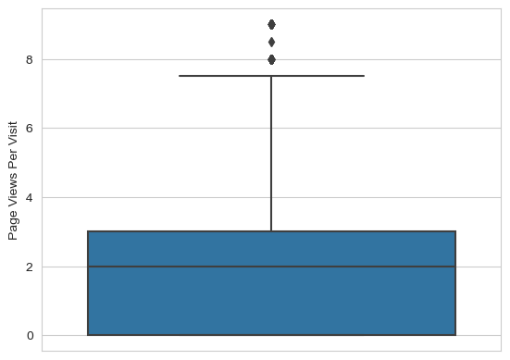
Data Analysis

Slide 8
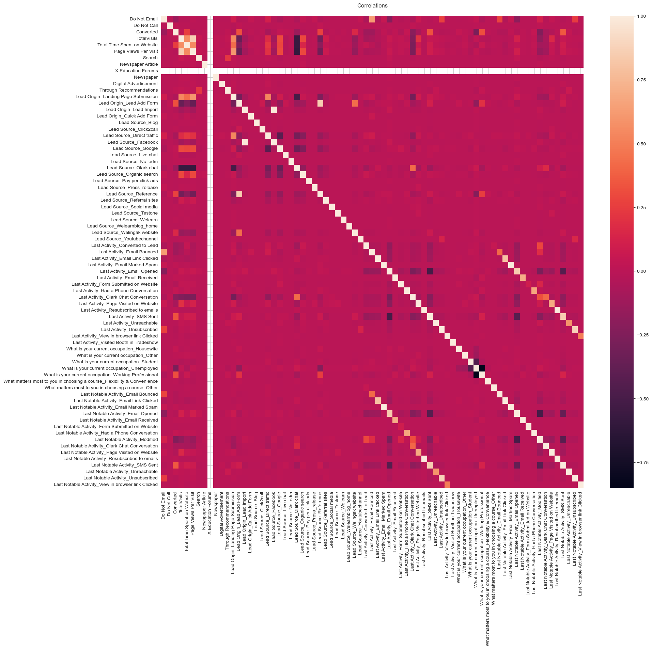
Correlation of the dataset¶

Slide 9
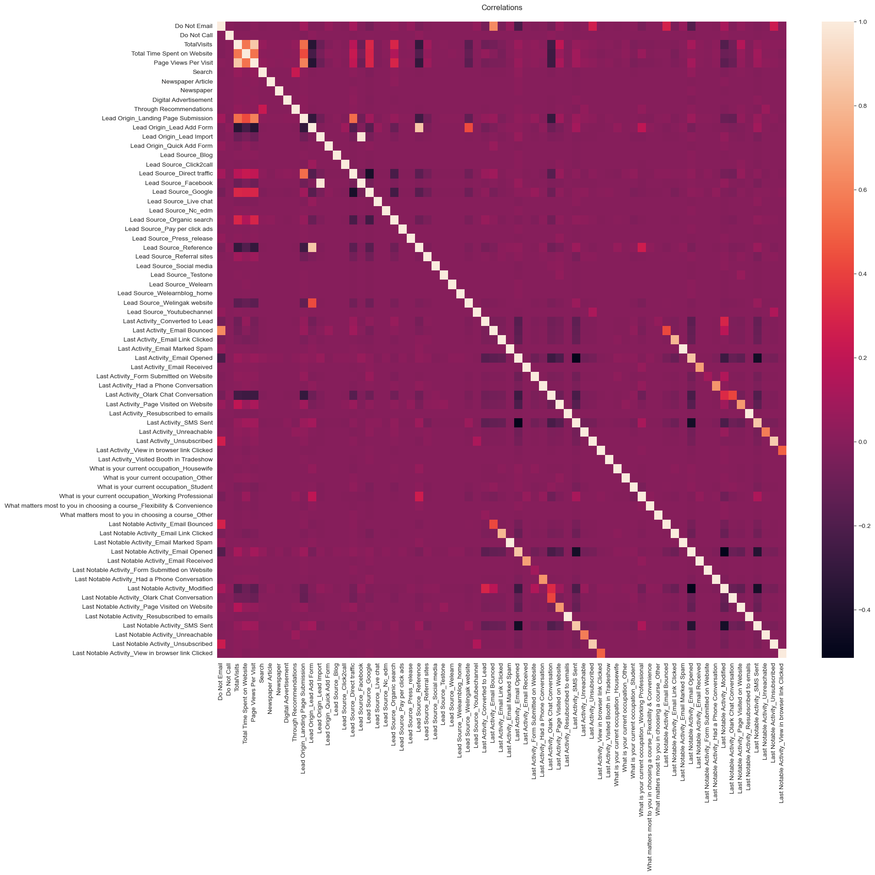
Here, X Education Forums has no data so, it is better to remove from the dataset. Also, we need to remove the highly correlated value.

Slide 10
Data Preparation
Converted binary variable into 0 and 1
Created dummy variables for categorical variables

Slide 11
Feature Scaling and Splitting Train and Test datasets
Feature Scaling of Numerical data
Splitting Data into Train and Test data

Slide 12
Model Building
Feature Selection using RFE
Determined optimal Model using Logical Regression
Calculated Accuracy, Sensitivity and Specificity
Precision and Recall to evaluate Model

Slide 13
Variables impacting the Conversion Rate
Total visits
Total Time spent on website
Lead Source_Olark Chat
Lead Origin_Lead Add Form
Lead Source_Welingac Website
Do not Email
Lead Source_Referral sites etc.

Slide 14
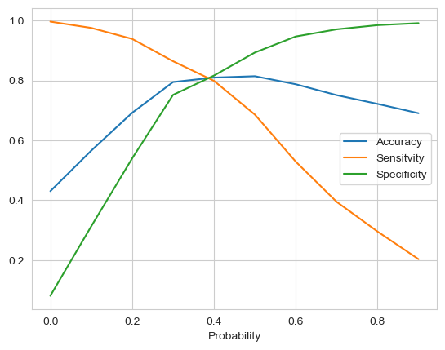
Model Evaluation- Sensitivity & Specificity on Train data Set
Graph depicts an optimal Cut off of 0.37
Based on Accuracy, Sensitivity & Specificity
Accuracy = 78%
Sensitivity = 82%
Specificity = 76%

Slide 15
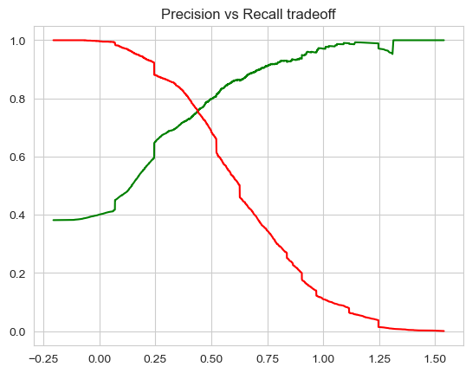
Model Evaluation Precision & Recall on Train Dataset
The graph depicts optimal cut off of 0.42 based on Precision and Recall
Precision = 79%
Recall = 65%

Slide 16
Model Evaluation Sensitivity & Specificity on Test Data Set
Accuracy = 80%
Sensitivity = 80.8%
Specificity = 76.5%

Slide 17
Model Evaluation Precision & Recall based on Test Data Set
Precision score in predicting test dataset: 0.725625539257981
Recall score in predicting test dataset: 0.788191190253046

Slide 18
Conclusion
The Accuracy, Precision and Recall score we got from the test data are in the acceptable region.
In business terms, this model has an ability to adjust with the company’s requirements in coming future.
Important features responsible for good conversion rate or the ones' which contributes more towards the probability of a lead getting converted are:
Last Notable Activity_Had a Phone Conversation
Lead Origin_Lead Add Form
What is your current occupation_Working Professional.

